Slide 1
Grokking
Algorithms
Aditya Y. Bhargava
Chapter 1, 2 and 3 recap
Mahmoud Elshahat

Slide 2
Introduction
01
Binary Search
02
Memory
Big O Notation
TABLE OF CONTENTS
04
03
Array - Linked List
05
Recursion
06
What we will learn ?
Better way to search. Binary vs linear seach.
How memory works and how data be stored.
Algorithm running time and how to calculate it
Linked Lists VS Arrays
(read – write – delete )
Base and recursive case.
The call stack.

Slide 3
01
Introduction

Slide 4
What We will learn
In beginning we should know that An algorithm is a set of instructions for accomplishing a task. Every piece of code could be called an algorithm.
compare trade-offs between different algorithms: Should you use merge sort or quicksort? Should you use an array or a list? Just using a different data structure can make a big difference
You’ll learn techniques for solving problems that might have been out of your grasp until now.
Some problems aren’t solvable in a timely manner! The part of this book that talks about NP-complete problems shows you how to identify those problems and come up with an algorithm that gives you an approximate answer.
by the end of this book, you’ll know some of the most widely applicable algorithms. You can then use your new knowledge to learn about more specific algorithms for AI, databases, and so on.

Slide 5
02
Binary search
A Better way to search.

Slide 6



Search Problems
Contacts
Facebook
Dictionary
suppose you log on to Facebook, Facebook has to verify that you have an account on the site. So, it needs to search for your username in its database.
searching for a person in contacts, heir name starts with K. You could start at the
beginning But you’re
more likely to start at a page in the middle.
suppose you’re searching for a word in a dictionary, and it
starts with O. Again, you’ll start near the middle.

Slide 7
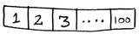
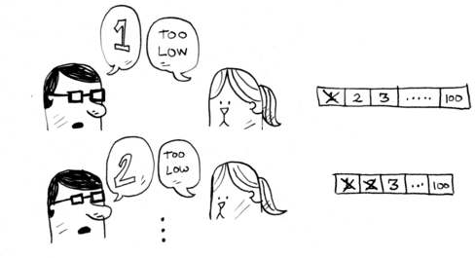
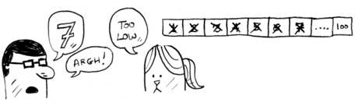
Basic way to search
I’m thinking of a number between 1 and 100.
You have to try to guess my number in the fewest tries possible. With every guess, I’ll tell you if your guess is too low, too high, or correct.

Slide 8
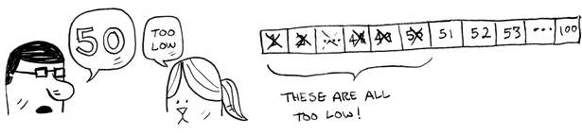

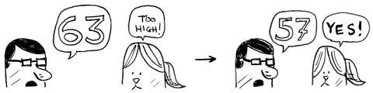
A better way to search
Here’s a better technique. Start with 50.
Too low, but you just eliminated half the numbers! Now you know that 1–50 are all too low. Next guess: 75.
Too high, but again you cut down half the remaining numbers! With binary search, you guess the middle number and eliminate half the remaining numbers every time. Next is 63 (halfway between 50 and 75).
This is binary search. You just learned your first algorithm!

Slide 9
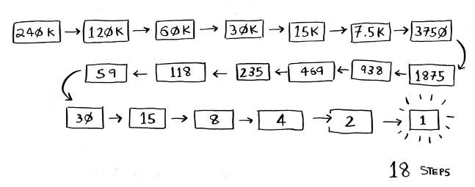
Example of both
Suppose you’re looking for a word in the dictionary. The dictionary has 240,000 words. In the worst case, how many steps do you think each search will take?
Simple search could take 240,000 steps if the word you’re looking for is the very last one in the book. With each step of binary search, you cut the number of words in half until you’re left with only one word.
Linear Search take O(n) while binary search takes O(log n).

Slide 10
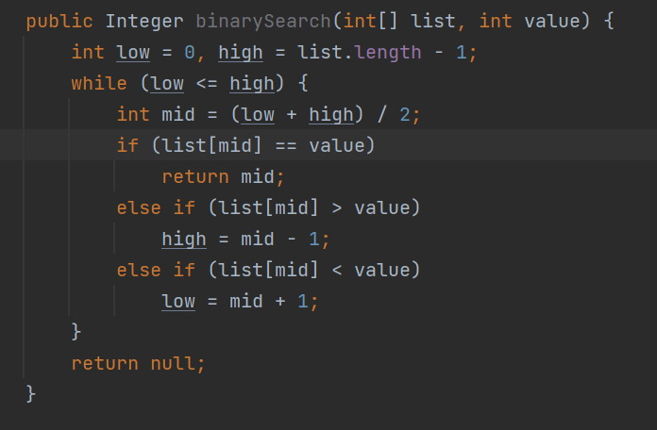
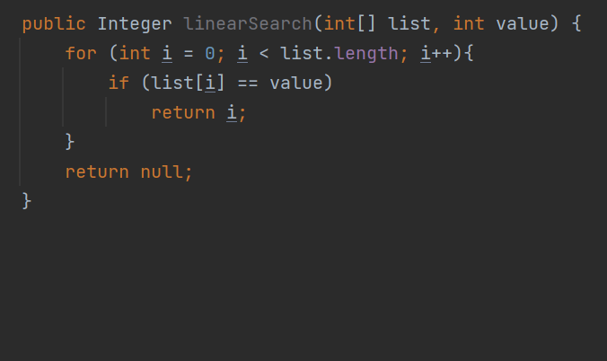
Code Part

Slide 11
03
Big O Notation
Algorithm running time and how to calculate it

Slide 12
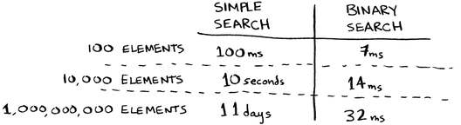
Big O Notaion
Big O notation is special notation that tells you how fast an algorithm is.
Bob is writing a search algorithm for NASA. His algorithm will kick in when a rocket is about to land on the Moon, and it will help calculate where to land, Bob is trying to decide between simple search and binary search, And Bob has only 10 seconds to figure out where to land
Bob decides to time both algorithms with a list of 100 elements, Let’s assume it takes 1 millisecond to check one element. With simple search, Bob has to check 100 elements.
But realistically, the list will have more like a billion elements. If it does, how long will simple search take? How long will binary search take?

Slide 13
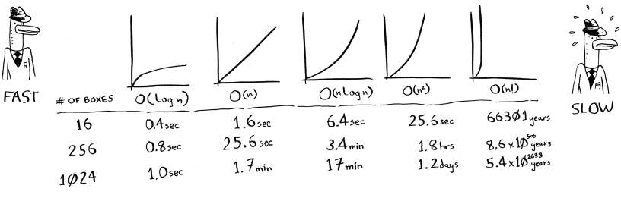
Common Big O run times
O(log n), also known as log time. Example: Binary search.
O(n), also known as linear time. Example: Simple search.
O(n * log n). Example: A fast sorting algorithm, like quicksort (coming up in chapter 4).
O(n2). Example: A slow sorting algorithm, like selection sort (coming up in chapter 2).
O(n!). Example: A really slow algorithm, like the traveling salesperson (coming up next!).
Suppose you’re drawing a grid of 16 boxes, and you can choose from 5 different algorithms to do so. If you use the first algorithm, it will take you O(log n) time to draw the grid. You can do 10 operations per second.

Slide 14
04
Memory
How memory works and how data be stored.

Slide 15
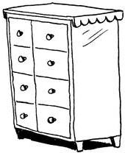
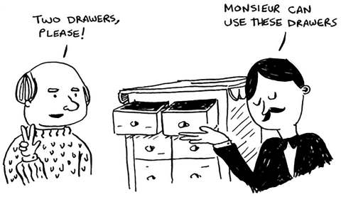
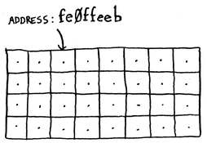
Memory
Imagine you go to a show and need to check your things. A chest of drawers is available.
Each drawer can hold one element.
You want to store two things, so you ask for two drawers.
Each time you want to store an item in memory,
you ask the computer for some space,
and it gives you an address where you can store your item.

Slide 16
05
Array - Linked List
Linked Lists VS Arrays (read – write – delete )

Slide 17
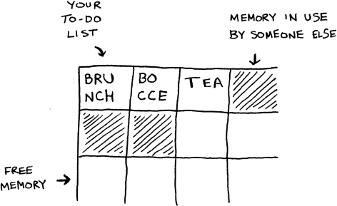
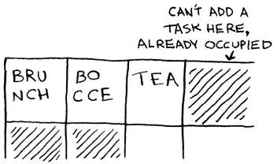
Array
Suppose you’re writing an app to manage your todos. You’ll want to store the todos as a list in memory
Should you use an array, or a linked list? Let’s store the todos in an array first.
It’s like going to a movie with your friends and finding a place to sit— but another friend joins you, and there’s no place for them. You have to move to a new spot where you all fit. In this case, you need to ask your computer for a different chunk of memory that can fit four tasks. Then you need to move all your tasks there.
One easy fix is to “hold seats”, even if you have only 3 items in your task list, you can ask the computer for 10 slots, just in case. Then you can add 10 items to your task list without having to move. This is a good workaround but?

Slide 18
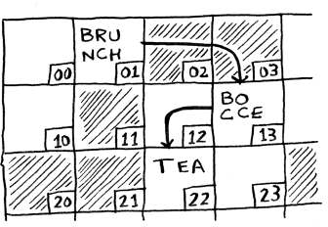
Linked List
With linked lists, your items can be anywhere in memory.
Each item stores the address of the next item in the list. A bunch of random memory addresses are linked together.
Let’s say you’re trying to find 10,000 slots for an array. Your memory has 10,000 slots, but it doesn’t have 10,000 slots together
So .. If linked lists are so much better at inserts, what are arrays good for?

Slide 19
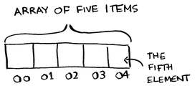
Linked List
Linked lists are great if you’re going to read all the items one at a time: you can read one item, follow the address to the next item, and so on. But if you’re going to keep jumping around, linked lists are terrible.
With linked lists, you never have to move your items. You also avoid another problem. Let’s say you go to a popular movie with five of your friends. The six of you are trying to find a place to sit, but the theater is packed. There aren’t six seats together
Arrays are different. You know the address for every item in your array. For example, suppose your array contains five items, and you know it starts at address 00. What is the address of item #5?

Slide 20
Array vs Linked List
 | Random Access | Sequential Access | Insertion | Deletion
Array | O ( 1 ) | O ( 1 ) | O ( n ) | O ( n )
Linked List | O ( n ) | O ( 1 ) | O ( 1 ) | O ( 1 )

Slide 21
06
Recursion
Base and recursive case -The call stack.

Slide 22
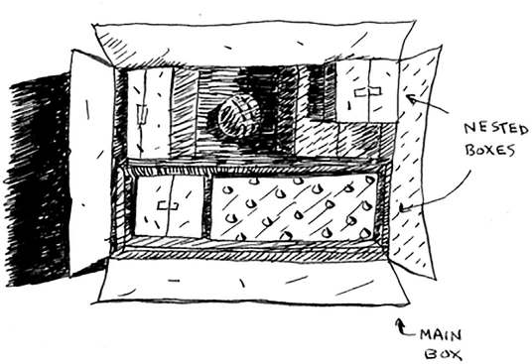
Example
Suppose you’re digging through your grandma’s attic and come across a mysterious locked suitcase.
Grandma tells you that the key for the suitcase is probably in this other box.
This box contains more boxes, with more boxes inside those boxes.
The key is in a box somewhere.

Slide 23
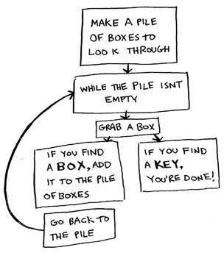
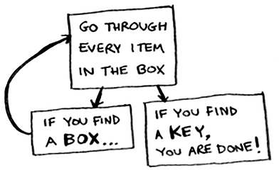
Performance
There’s no performance benefit to using recursion; in fact, loops are sometimes better for performance.
Quote by Leigh Caldwell on Stack Overflow: “Loops may achieve a performance gain for your program. Recursion may achieve a performance gain for your programmer. Choose which is more important in your situation!”

Slide 24
Base case – Recursive case
Example, suppose you want to write a function that prints a countdown, like this: > 3...2...1
You can write it recursively, like so:
But you need to write Base case to tell your function when to stop calling itself
Code can be like so:
public static void countdown(int num){ System.out.println(num); countdown(num - 1); }
public static void countdown(int num){ if(num<=0) //Base case return; System.out.println(num); countdown(num - 1); // Recursive case }

Slide 25
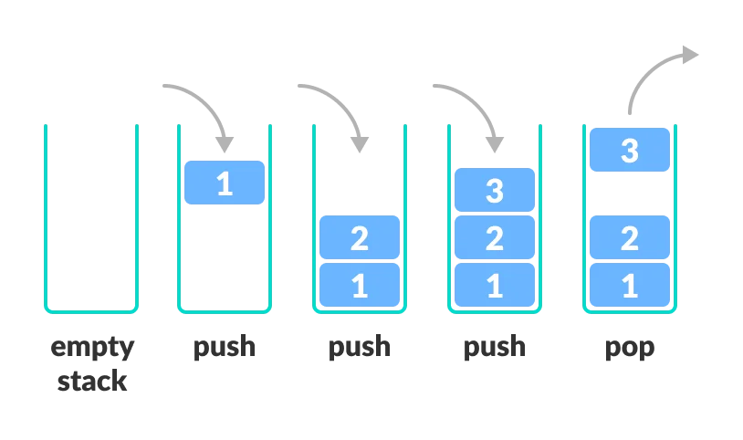
Stack
Stack is a linear data structure which follows a particular order in which the operations are performed. The order may be LIFO(Last In First Out) or FILO(First In Last Out).
Image from https://www.programiz.com/

Slide 26
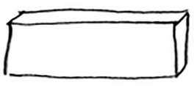
The call stack
Your computer uses a stack internally called the call stack.
Let’s walk through what happens when you call a function.
Suppose you call greet(“maggie”), First, your computer allocates a box of memory for that function call.
public void greet2(String name){ System.out.println("how are you, "+ name +"?"); } public void bye(){ System.out.println("Ok bye!"); } public void greet(String name){ System.out.println("hello, "+name + "!"+greet2(name)); System.out.println("getting ready to say bay ..."); bye(); }

Slide 27
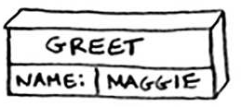
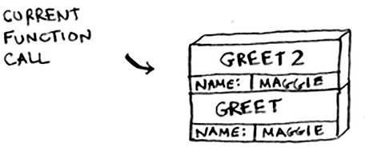
The call stack
Now let’s use the memory. The variable name is set to “maggie”. That needs to be saved in memory.
Every time you make a function call, your computer saves the values for all the variables for that call in memory like this. Next, you print hello, maggie! Then you call greet2(“maggie”). Again, your computer allocates a box of memory for this function call.

Slide 28
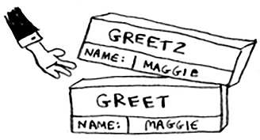
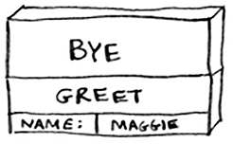
The call stack
Your computer is using a stack for these boxes. The second box is added on top of the first one. You print how are you, maggie? Then you return from the function call. When this happens, the box on top of the stack gets popped of.
When you called the greet2 function, the greet function was partially completed.
when you call a function from another function, the calling function is paused in a partially completed state.
All the values of the variables for that function are still stored in memory. Now that you’re done with the greet2 function, you’re back to the greet function, and you pick up where you left of.
First you print getting ready to say bye…. You call the bye function.

Slide 29
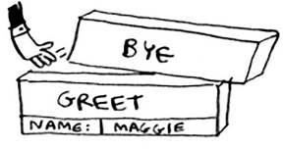
The call stack
A box for that function is added to the top of the stack. Then you print ok bye! and return from the function call.
And you’re back to the greet function. There’s nothing else to be done, so you return from the greet function too. This stack, used to save the variables for multiple functions, is called the call stack.

Slide 30
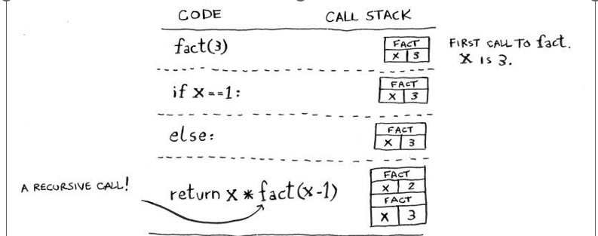
The call stack with recursion
Recursive functions use the call stack too! Let’s look at this in action with the factorial function.
Now suppose you call fact(3). Let’s step through this call line by line and see how the stack changes. Remember, the topmost box in the stack tells you what call to fact you’re currently on.
First call
public int fact(int num) { if (num == 1) return 1; else return num * fact(num - 1); }

Slide 31
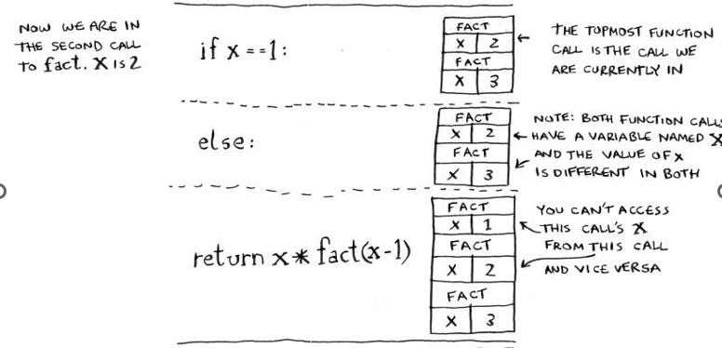
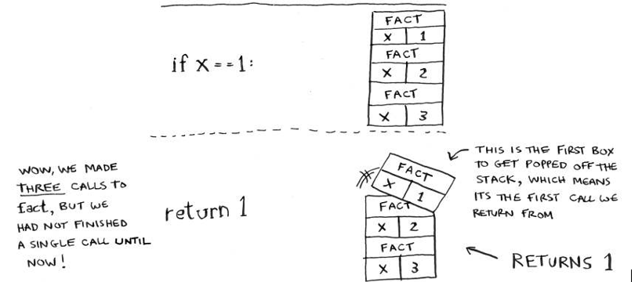
The call stack
Second Call
Third Call

Slide 32
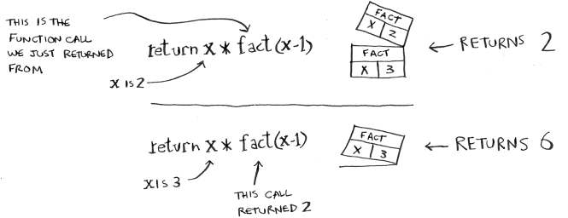
The call stack
Last Call

Slide 33
THANKS
Does anyone have any questions?
mahmoudahmedsm@gmail.com

